Slide 1



Slide 2
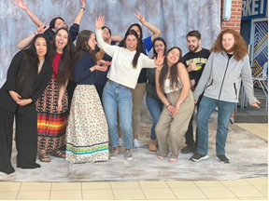
Fundraising for your chapter!
We know fundraising is important for your chapter and that it helps your members attend events such as the National Conference, Regional Conference and Leadership Summit.
Fundraising can be complicated but it can also be fun! Here are some tips to help your chapter.

Slide 3
Fundraising Needs:
Decide on the event you want to fundraise for and set a goal.
Questions to consider:
Are you flying? Or driving?
How many rooms do you need?
Is food provided?
How many people want to go?
Why are you attending? (Example: Is there funding specifically for your presentation?)
What are the benefits? (You can include why it’s important for your chapter to attend when seeking sponsorship)

Slide 4
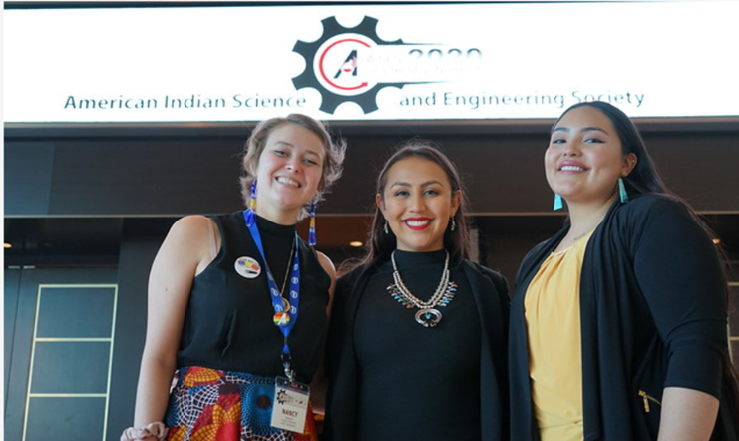
Finding resources through your school:
Check in with your advisor to see if your department has funding for travel or conferences.
Some colleges/universities have digital funding sites set up. (Fundly, Venmo, GoFundMe.)
Check in with your student center to see if they have travel scholarships or grants.
There may be an opportunity for sponsorship.
See if you can get a government rate on hotel rooms through your university.

Slide 5

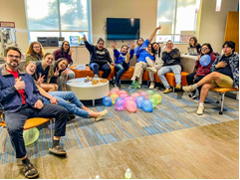
Fundraising on campus:
Find an event on campus and see if there is an opportunity to sell goods/food.
Create colorful flyers/announcements.
Collaborate with another organization on campus and plan an event where you can split the profits. (Example: Pow Wow, Movie Night, Game Night)

Slide 6

Fundraising in the community:
Set up at local community gatherings to sell. (Example: Pow Wow, Farmer’s Market, Community Market, Holiday Craft Sales.)
Host a raffle, community haunted house, pumpkin carving, food sales or anything else unique to your chapter and community.
Check in with tribal community center or tribal leadership to see if they are willing to fund travel or conference expenses.

Slide 7
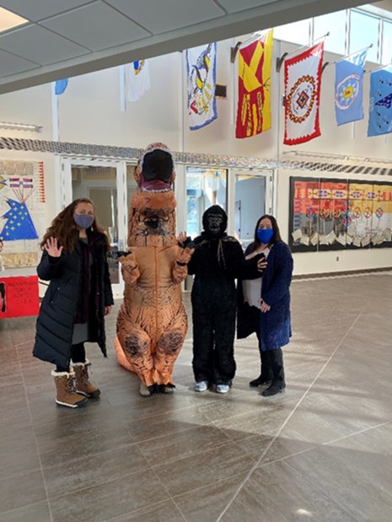
Fundraising in the community:
Seek sponsorship through local businesses.
Check in Professional Chapters to see if they have funding for travel or scholarships available.

Slide 8

Important Reminders for Chapters!
Check AISES.org for travel scholarships.
Annual reports are due in May. Please fill out the form located on the website.
Chapter updates are due in October. Please take this opportunity to update your chapter officer/advisor information if things have changed.
Reports are important to complete so AISES Headquarters knows who to contact with opportunities, resources and upcoming activities.
Reach out to AISES Headquarters with any questions.

Slide 9
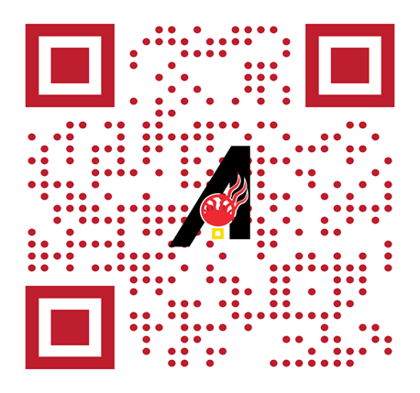
Additional information:
Director of Chapter Engagement - Shelly Dreadfulwater, sdreadfulwater@aises.org
Membership Manager- Kaitlin Lyons, klyons@aises.org

